Slide 1
Data analysis
Janvi Ambaliya

Slide 2
introduction
Data analysis is used across various domains, including business, healthcare, social sciences, and engineering, to make informed decisions, identify trends, and uncover insights that can lead to actionable strategies and solutions.

Slide 3
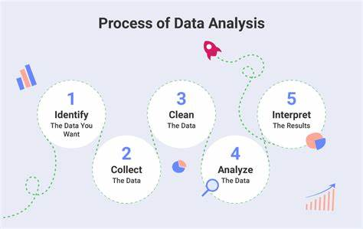

Slide 4
Why its useful
data analysis is a powerful tool that transforms raw data into valuable insights, facilitating better decision-making, efficiency, innovation, and overall success in various domains.

Slide 5
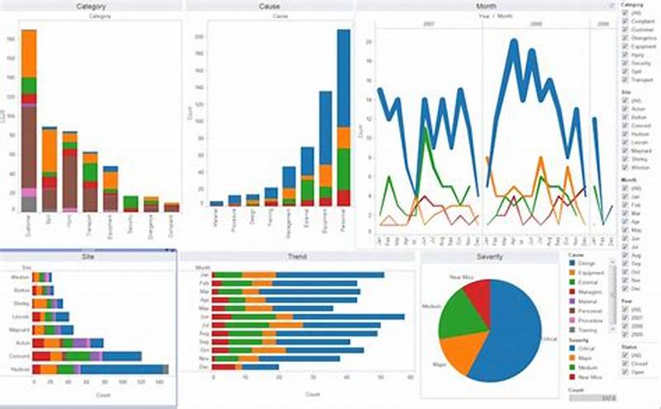
Main perspectives

Slide 6
conclusion
The ability to draw actionable conclusions from data not only provides a competitive edge but also supports the development of personalized solutions and the advancement of scientific research. Embracing data analysis is essential for anyone looking to make data-driven decisions and achieve strategic objectives in today's data-centric world.

Slide 7
Thank you

